Slide 1



Nigeria Agricultural Export Report
View in Power BI
Last data refresh:
6/4/2024 11:20:06 AM UTC
Downloaded at:
6/4/2024 11:23:04 AM UTC

Slide 2
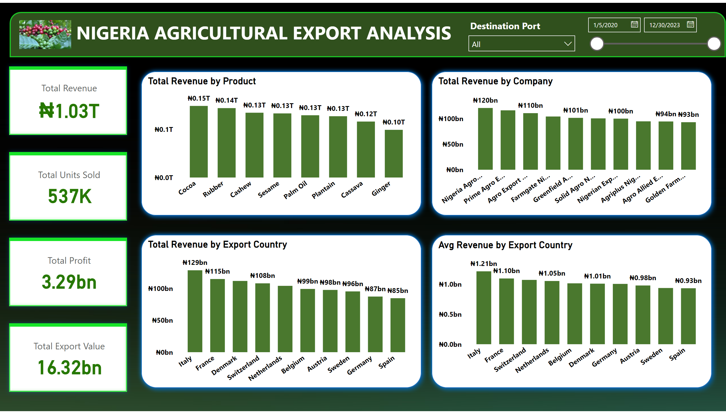
Home
Notes:
cardVisual
No alt text provided
shape
No alt text provided
shape
No alt text provided
shape
No alt text provided
shape
No alt text provided
Total Revenue by Product
No alt text provided
Total Revenue by Company
No alt text provided
Total Revenue by Export Country
No alt text provided
Avg Revenue by Export Country
No alt text provided
shape
No alt text provided
image
No alt text provided
textbox
No alt text provided
slicer
No alt text provided
slicer
No alt text provided

Slide 3
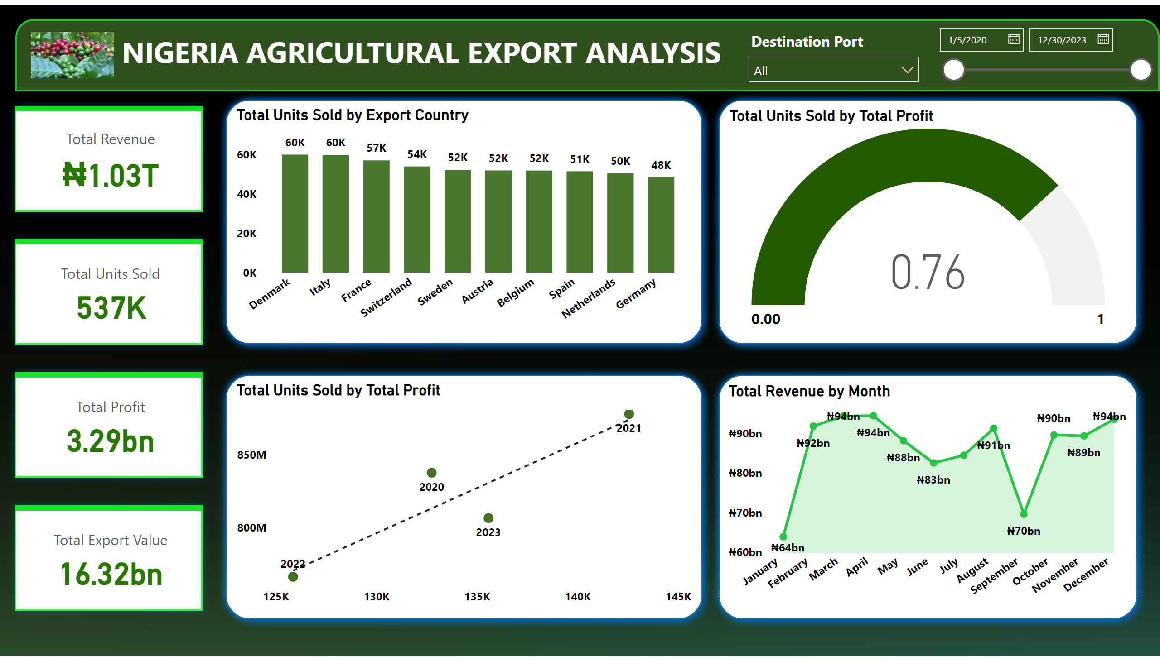
Financial Performance
Notes:
cardVisual
No alt text provided
shape
No alt text provided
shape
No alt text provided
shape
No alt text provided
shape
No alt text provided
Total Units Sold by Export Country
No alt text provided
shape
No alt text provided
image
No alt text provided
textbox
No alt text provided
slicer
No alt text provided
slicer
No alt text provided
Total Units Sold by Total Profit
No alt text provided
Total Units Sold by Total Profit
No alt text provided
Total Revenue by Month
No alt text provided

Slide 4
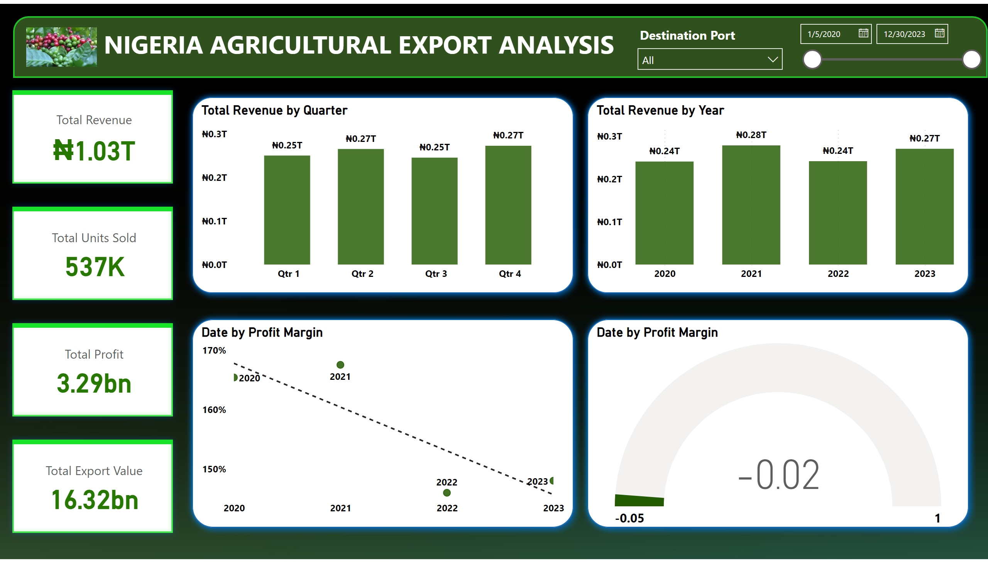
Financial Analysis
Notes:
cardVisual
No alt text provided
shape
No alt text provided
shape
No alt text provided
shape
No alt text provided
Date by Profit Margin
No alt text provided
Date by Profit Margin
No alt text provided
shape
No alt text provided
Total Revenue by Year
No alt text provided
Total Revenue by Quarter
No alt text provided
shape
No alt text provided
image
No alt text provided
textbox
No alt text provided
slicer
No alt text provided
slicer
No alt text provided

Slide 5
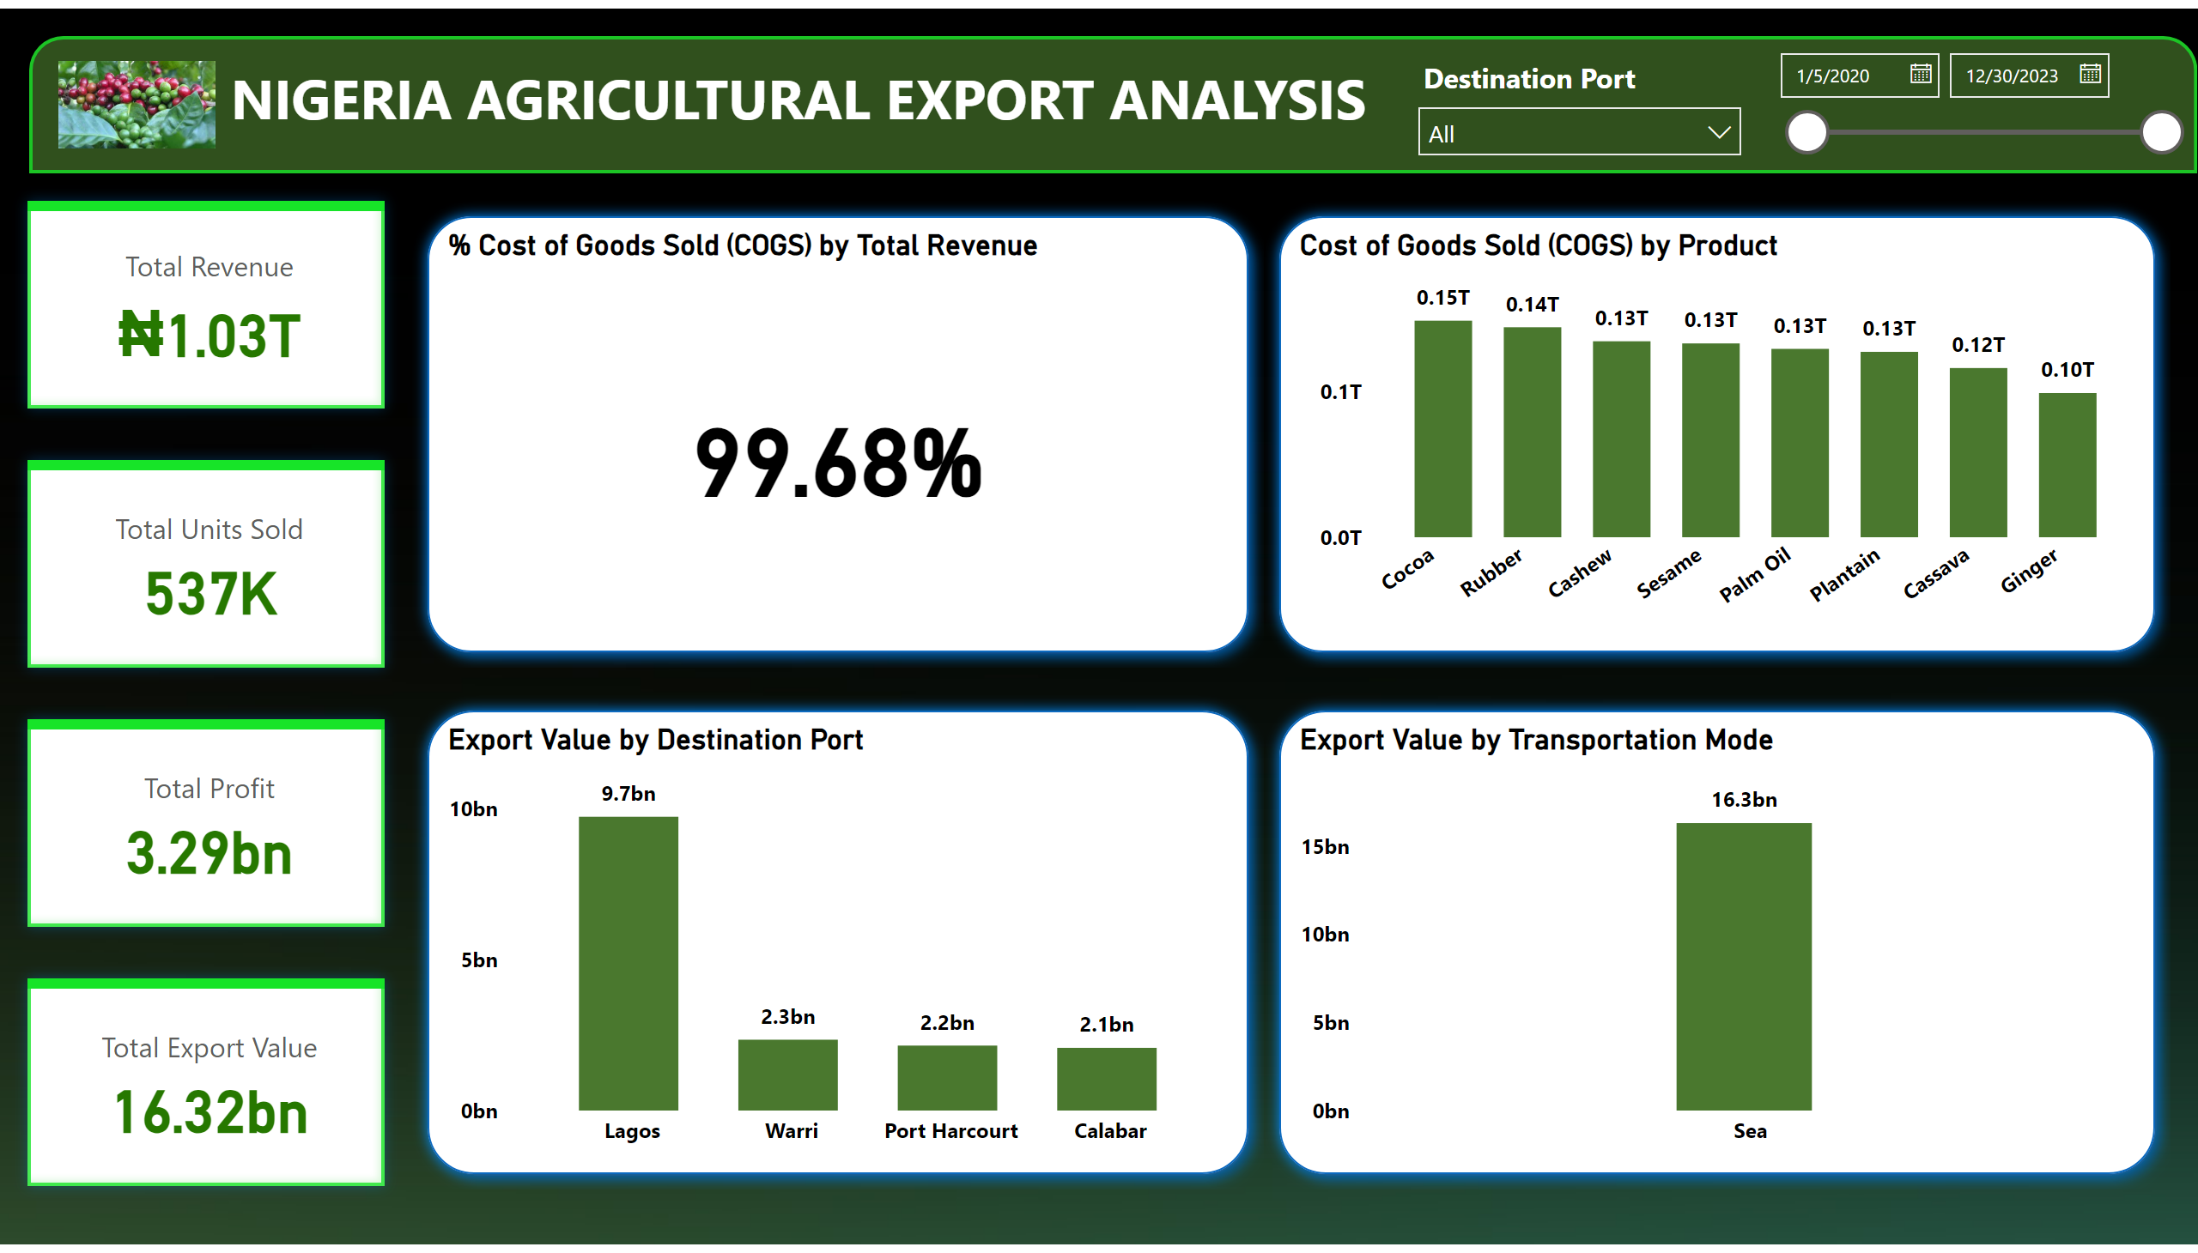
Cost Analysis / Geographic Data
Notes:
cardVisual
No alt text provided
shape
No alt text provided
shape
No alt text provided
shape
No alt text provided
Cost of Goods Sold (COGS) by Product
No alt text provided
shape
No alt text provided
% Cost of Goods Sold (COGS) by Total Revenue
No alt text provided
shape
No alt text provided
image
No alt text provided
textbox
No alt text provided
slicer
No alt text provided
slicer
No alt text provided
Export Value by Destination Port
No alt text provided
Export Value by Transportation Mode
No alt text provided

Slide 6
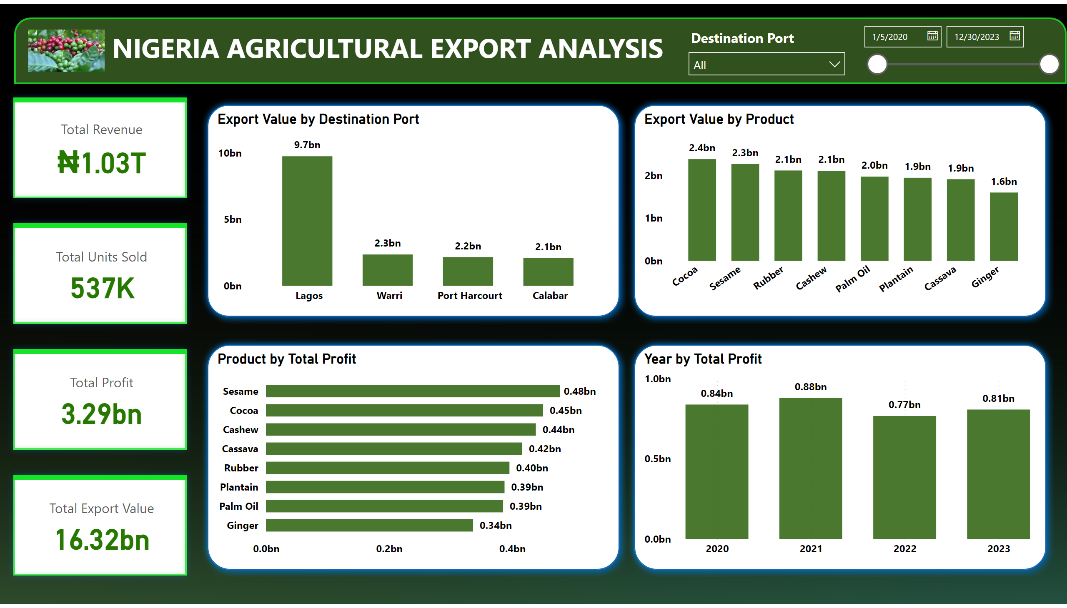
Destination Ports
Notes:
cardVisual
No alt text provided
shape
No alt text provided
textbox
No alt text provided
shape
No alt text provided
shape
No alt text provided
shape
No alt text provided
Year by Total Profit
No alt text provided
shape
No alt text provided
Export Value by Destination Port
No alt text provided
Export Value by Product
No alt text provided
slicer
No alt text provided
slicer
No alt text provided
image
No alt text provided
Product by Total Profit
No alt text provided

Slide 7
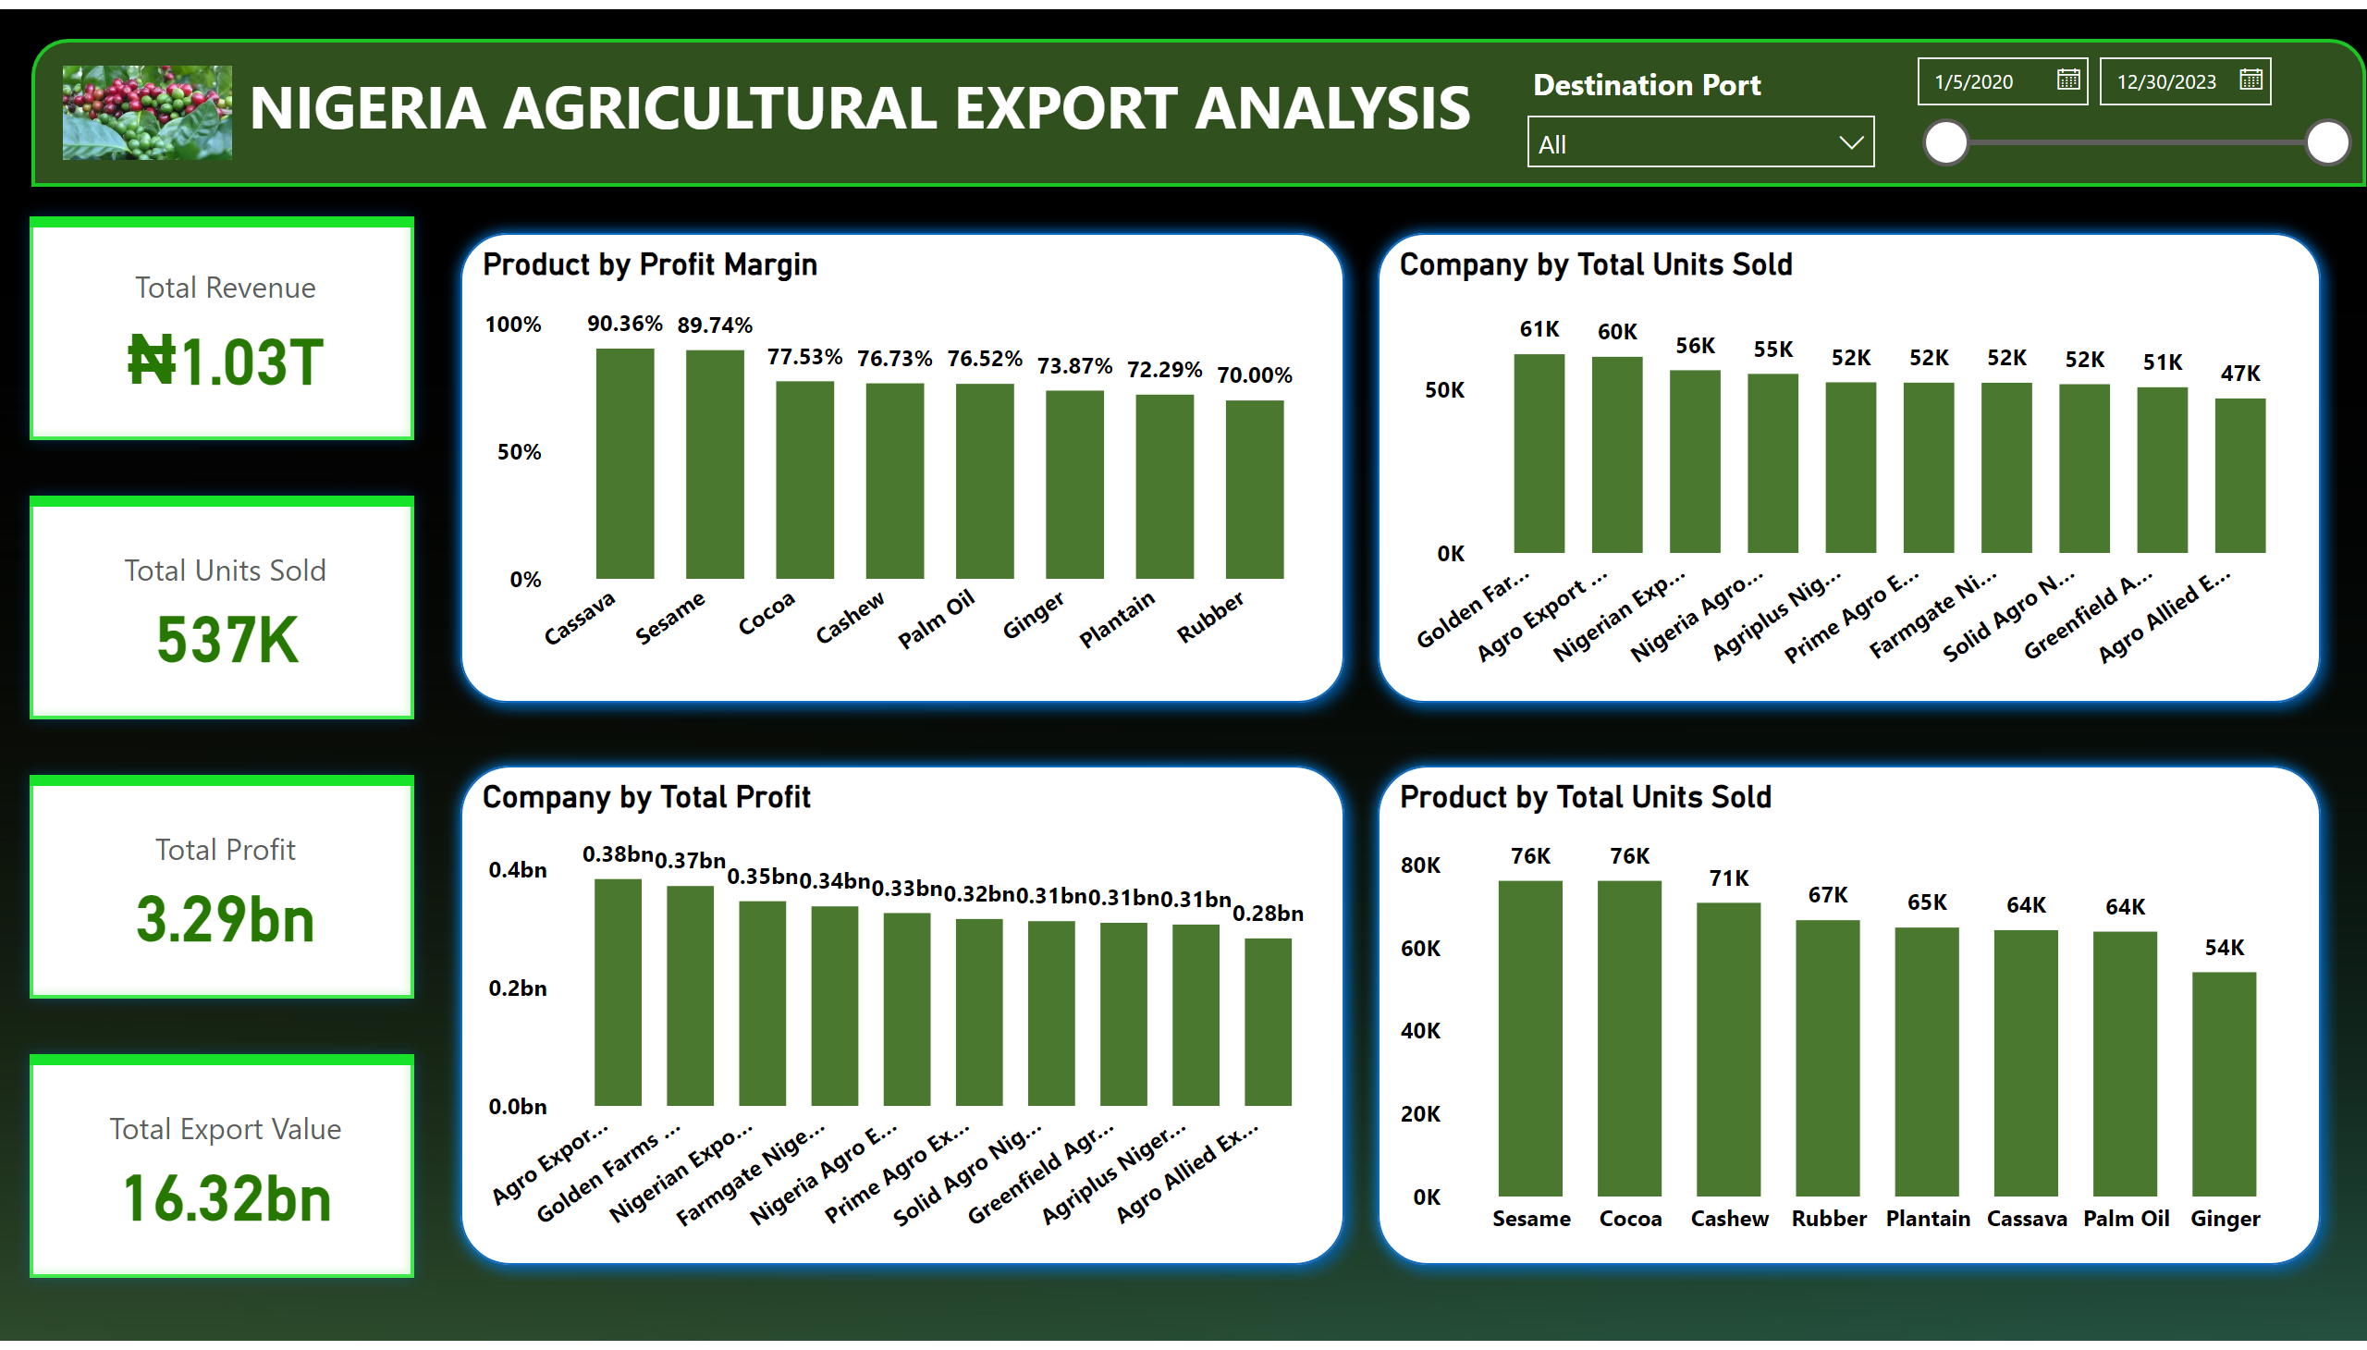
Profit Analysis
Notes:
cardVisual
No alt text provided
shape
No alt text provided
shape
No alt text provided
shape
No alt text provided
Product by Total Units Sold
No alt text provided
shape
No alt text provided
Product by Profit Margin
No alt text provided
Company by Total Units Sold
No alt text provided
Company by Total Profit
No alt text provided
shape
No alt text provided
image
No alt text provided
textbox
No alt text provided
slicer
No alt text provided
slicer
No alt text provided

